Slide 1
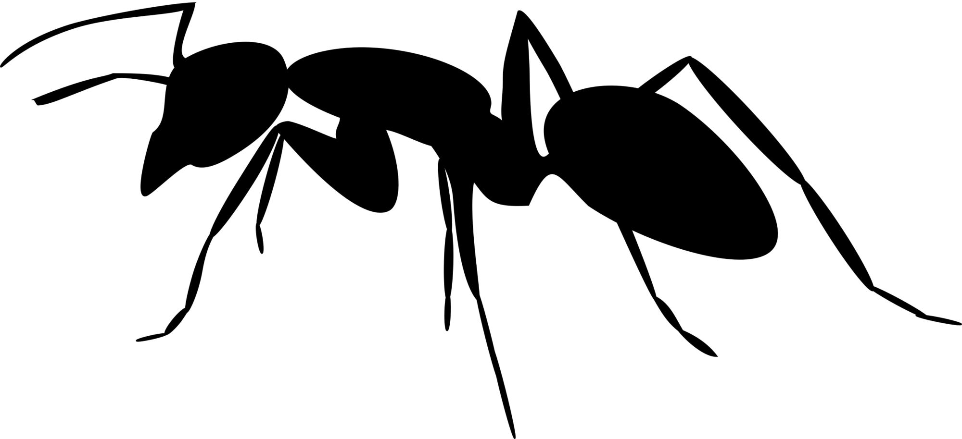
Ant Colony Optimization for Continuous Spaces
Chinedu Mc-Niel
iammcniel@gmail.com
Department of Computer Sciences,
University of Lagos,
Lagos, Nigeria.

Slide 2
ABSTRACT
Swarm intelligence is a relatively new problem-solving method based on the social behaviour of insects and other animals. Ant Colony Optimization (ACO), one of the most popular Swarm Intelligence techniques is based on the foraging behaviour of certain ant species that deposit pheromones in the soil to indicate faster favourable food source routes to other members of the ant colony. ACO algorithms have been applied to many different discrete optimization problems. In this work, ACO was used to solve continuous space optimization problems. The first proposed algorithm for optimising continuous functions is Continuous Ant Colony Optimization (CACO) It uses the structure of the ant colony to perform a local search, while the global search is handled by a genetic algorithm. Here probability density functions were used to model the ACO's pheromone and the new ACO was benchmarked using standard benchmark functions.

Slide 3
Swarm Intelligence
Swarm intelligence (SI) is one of the computational intelligence techniques which are used to solve complex problem. SI involves collective study of the individuals behaviour of population interact with one another locally. Especially for biological systems nature often act as an inspiration. Simple rules are followed by agents and no centralized control structure exists in order to predict the behaviour of individual agents. The random iteration of certain degree between the agents provides an “intelligent” behavior which is then unknown to individual agents. 3 popular SI algorithms include:
Particle Swarm Optimization (PSO)
Artificial Bee Colony (ABC)
Ant Colony Optimization (ACO)

Slide 4
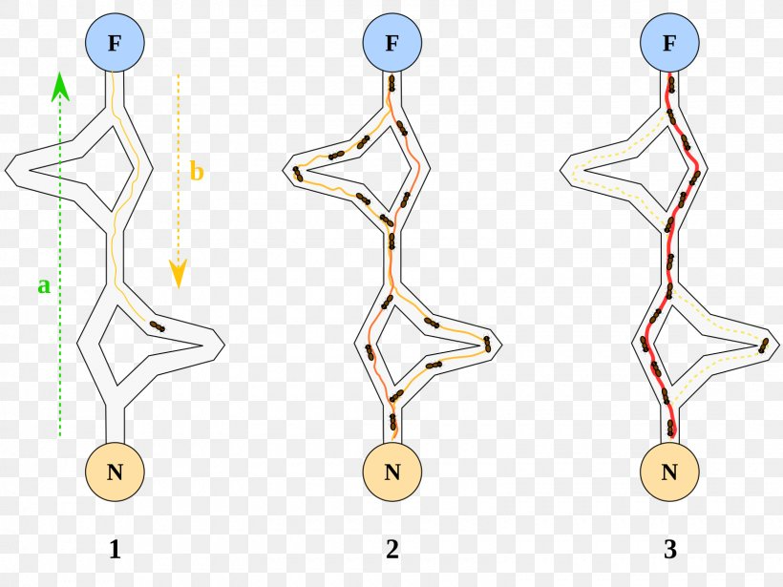
Ant Colony Optimization
Ant Colony Optimization is a metaheuristic for solving difficult combinatorial optimization problems,
It is inspired by the pheromone (a natural chemical found in insects or animals) laying nature of some real ant species.
Ants use pheromones as a means of communication when searching for food sources.

Slide 5
Major Applications
From the early nineties, when the first ant colony optimization algorithm was proposed, ACO attracted the attention of increasing numbers of researchers and many successful applications are now available. Moreover, a substantial collection of theoretical results is becoming available that provides useful guidelines to researchers and practitioners in further applications of ACO. There exist now a considerable number of applications of such algorithms where world class performance is obtained. Examples are applications of ACO algorithms to problems such as sequential ordering [76], scheduling [18], assembly line balancing [19], probabilistic TSP [7], 2D-HP protein folding [132], DNA sequencing [25], protein–ligand docking [98], and packet-switched routing in Internet-like networks

Slide 6
Discrete vs Continous Space Problems
Discrete or Combinatorial Optimization deals mainly with problems where we have to choose an optimal solution from a finite (or sometimes countable) number of possibilities.
Continuous optimization entails finding the minimum or maximum value of a function of one or many real variables, subject to constraints. The constraints usually take the form of equations or inequalities.
Continuous optimization is the core mathematical science for real-world problems ranging from design of biomolecules to management of investment portfolios.

Slide 7
Ant Colony for Continuos Spaces
It is important to notice that certain problems may be transformed from combinatorial to continuous form by relaxing the requirement of having the values from a finite set. In the evaluation of the objective function, the continuous values may be then rounded to the nearest value from the initial set. Similarly, it is also possible to transform the continuous problem into the combinatorial one by dividing the continuous domains into a set of values. This however is only possible if the continuous domain is bounded (i.e., the lower and upper bounds are defined).

Slide 8
ACOm
decay (float): Rate it which pheromone decays. The pheromone value is multiplied by decay, so 0.95 will lead to decay, 0.5 to much faster decay.
alpha (int or float): exponent on pheromone, higher alpha gives pheromone more weight. Default=1
beta (int or float): exponent on distance, higher beta give distance more weight. Default=1
pheromone (int or float): Pheromone is calculated as the Sample standard Functions
distance (2D numpy.array): Square matrix of distance. Diagonal is assumed to be np.inf.
n_ants (int): Number of ants running per iteration
n_best_ants (int): Number of best ants who deposit pheromone

Slide 9
ACOm
ACOm Metaheuristics
Set parameters, initialize artificial pheromone trails
while Termination Criteria Not Met do
Construct Ant Solutions
Apply Local Search
Update artificial pheromone
end while

Slide 10
Sample Problems
Below are three of sample test functions selected and used for comparing ACOm to ACOR asted to other ant-related algorithms and other metaheuristics adapted for continuous optimization. These problems and the results were taken from the work done by Socha and M. Dorigo [Ant colony optimization for continuous domains, European Journal of Operations Research, 185(3):1155–1173, 2008]

Slide 11
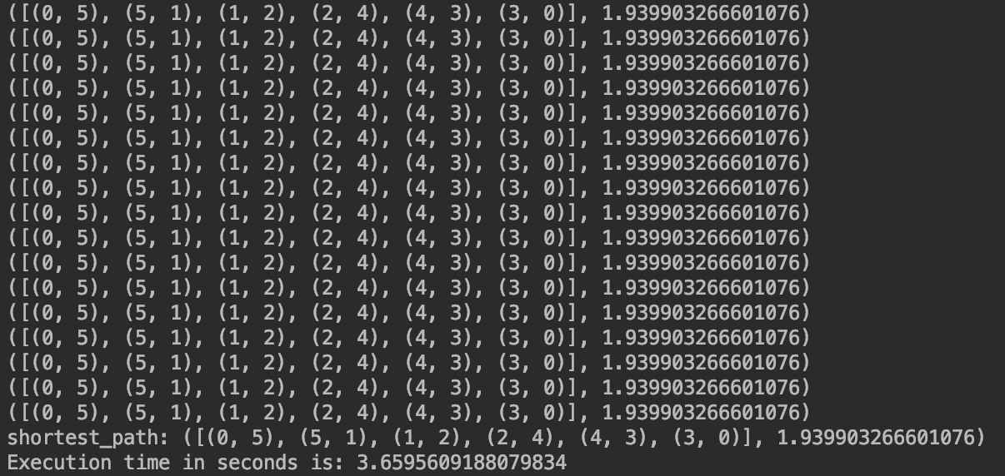
Results
Rosenbrock (R2)

Slide 12
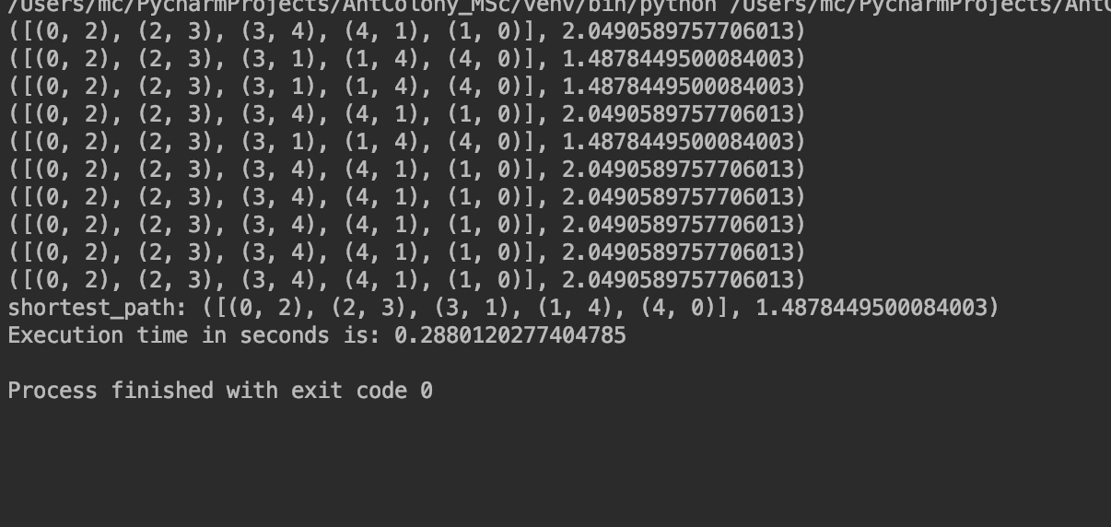
Results
Greiwank (GR10)

Slide 13
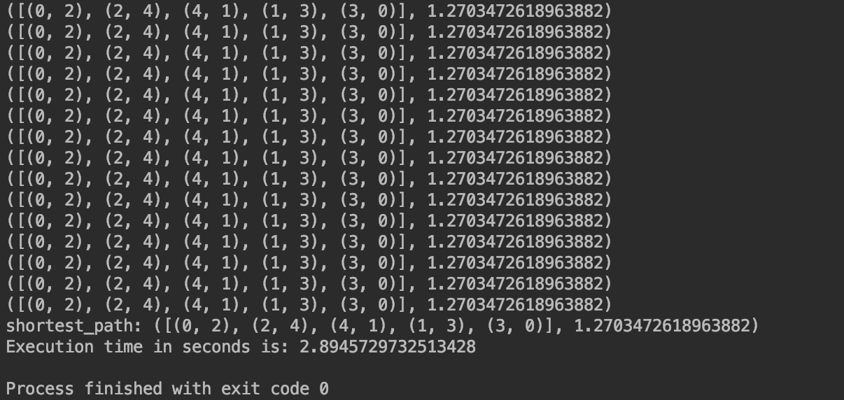
Results
Sphere

Slide 14
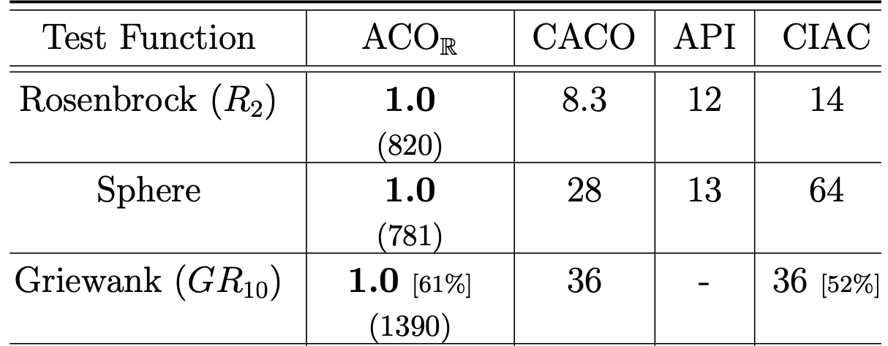
Results
ACOm
1.9
1.2
1.4

Slide 15
Further Work
My ACOm algorithms are not as competitive as ACOr that is proposed by Dr Socha and Prof Dorigo. It however perfomed better than CACO and other tested ACO methods for Continuos Space Problems.
I would run more tests with the varying weights on the pheromone or the distance to ascertain if those would give better results.

Slide 16
References
Socha and M. Dorigo (2008). Ant colony Optimization for Continuous Domains, European Journal of Operations Research, 185(3):1155–1173
Afshar, A., Massoumi, F., Afshar, A., & Mariño, M. A. (2015). State of the Art Review of Ant Colony Optimization Applications in Water Resource Management. Springer Science+Business Media Dordrecht 2015, 3891-3904.
Anand, N., & Rajeshwar, S. (2017). Ant Colony Optimization (ACO) based Routing Protocols for Wireless Sensor Networks (WSN): A Survey. (IJACSA) International Journal of Advanced Computer Science and Applications, Vol. 8, No. 2, 148-155.
Dorigo, M., Birattari, M., & tzle, T. S. (2006, November). Ant Colony Optimization (Artificial Ants as a Computational Intelligence Technique). IEEE COMPUTATIONAL INTELLIGENCE MAGAZINE, pp. 28-39.
Gendreau, M., & Potvin, J.-Y. (2010). International Series in Operations Research & Management Science. In M. G.-Y. Potvin, Handbook of Metaheuristics (pp. 227-264). London: Springer.
Jr., I. F., Yang, X.-S., Fister, I., Brest, J., & Fister, D. (2013). A Brief Review of Nature-Inspired Algorithms for Optimization. ELEKTROTEHNISˇKI VESTNIK, 1-7.
Jun-man, K., & Yi, Z. (2012). Application of an Improved Ant Colony on Generalised Travelling Salesman Problem. Energy Procedia 17, 319-325.
Lee, C.-Y., Lee, Z.-J., Lin, S.-W., & Ying, K.-C. (2008). An enhanced ant colony optimization (EACO) applied to capacitated vehicle routing problem. Springer Science+Business Media, LLC 2008, 88-95.

